Slide 1
GPU Acceleration
Rabab Alomairy & Evelyne Ringoot

Slide 2

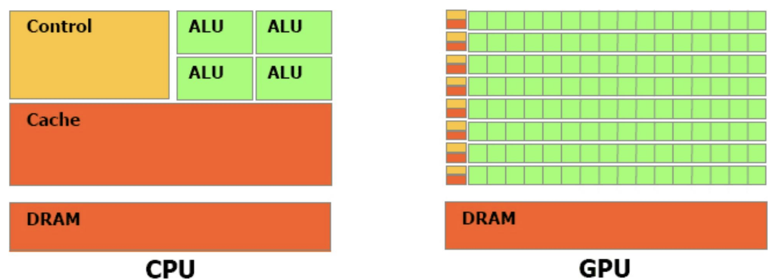
GPU vs. CPU
Latency Oriented Bandwidth Oriented

Slide 3
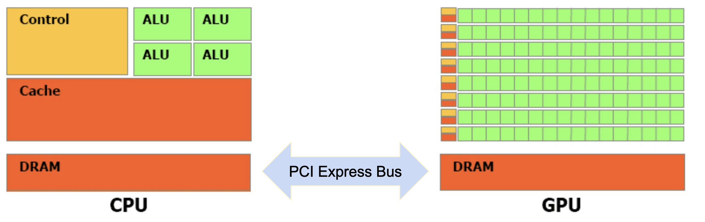
Heterogeneous architecture
Latency Oriented Bandwidth Oriented

Slide 4
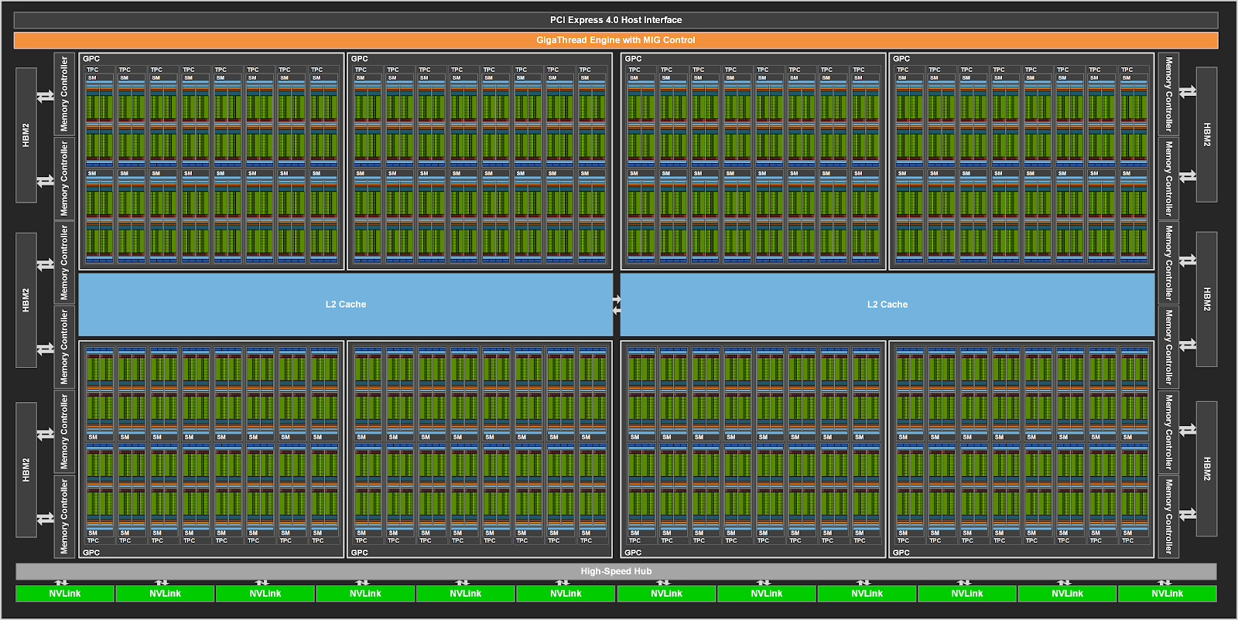
Overview of GPU Architecture
Transistor Count: 54.2 billion
Die Area: 826 mm²
Architecture: Ampere
Memory: Up to 80 GB HBM2e
Peak FP64 Performance: ~19.5 TFLOP/s (A100 80GB SXM)
Interconnect: NVLink (up to 600 GB/s), PCIe Gen4
128 SMs per full GPU

Slide 5
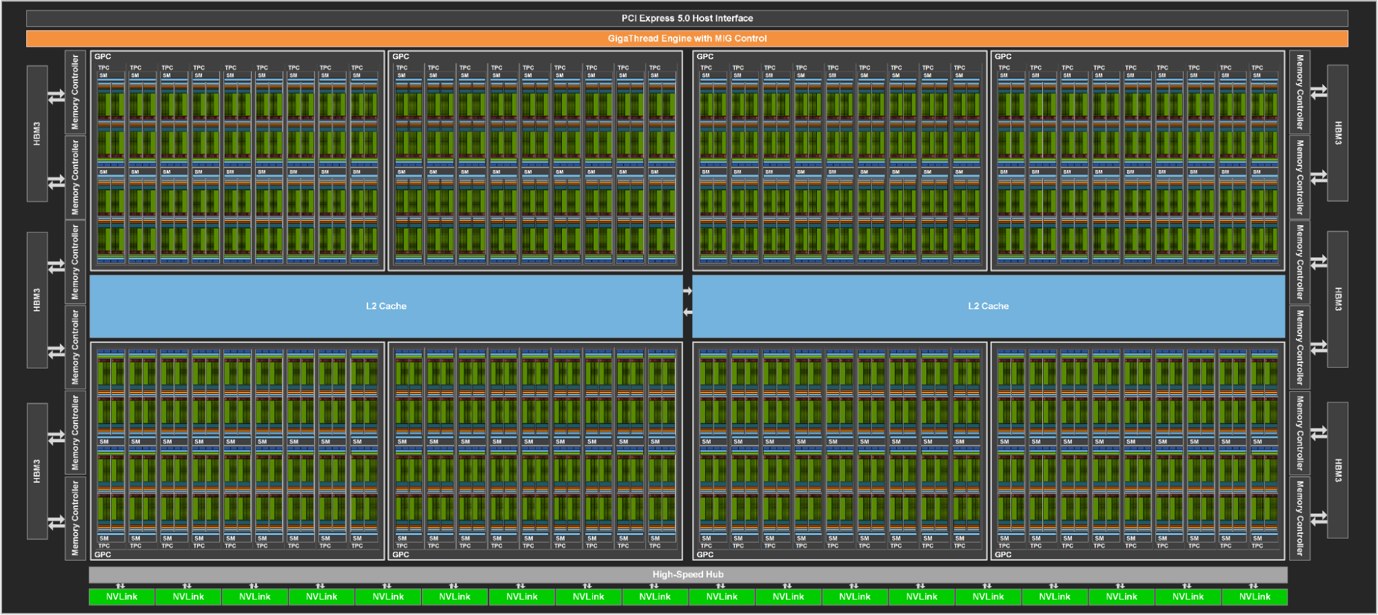
Overview of GPU Architecture
Transistor Count: 80 billion
Die Area: 814 mm²
Architecture: Hopper
Memory: Up to 96 GB HBM2e
Peak FP64 Performance: ~34 TFLOP/s (H100 96GB SXM)
Interconnect: NVLink (up to 900 GB/s), PCIe Gen4
132 SMs per full GPU

Slide 6
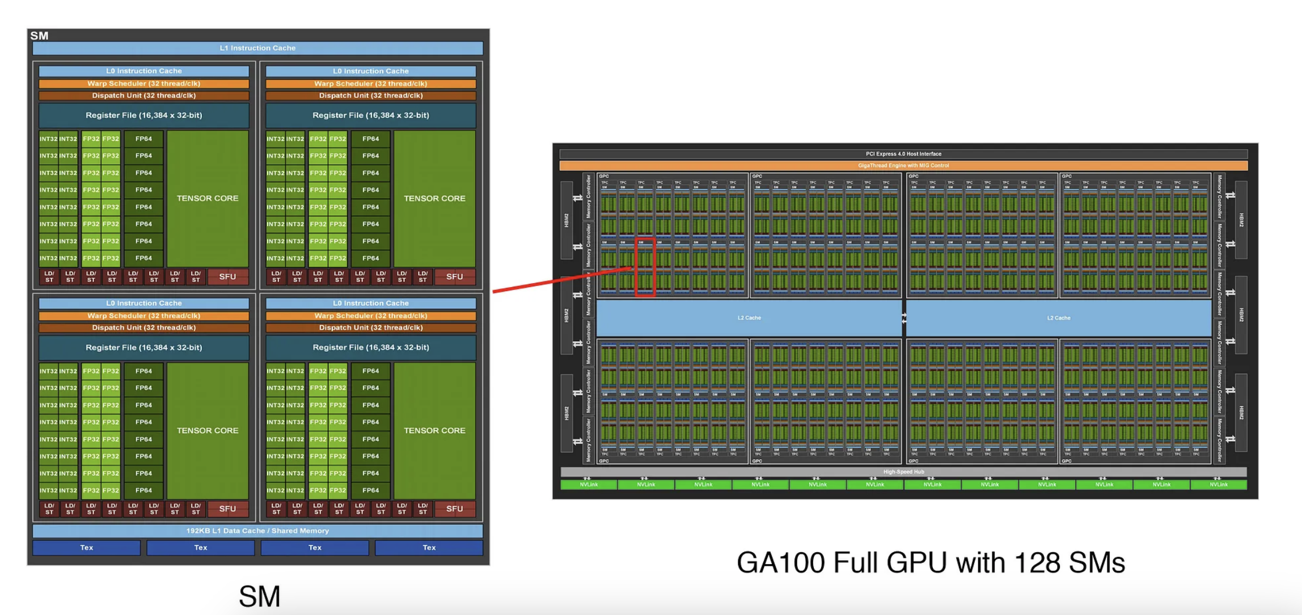
Streaming multiprocessor (SM)

Slide 7
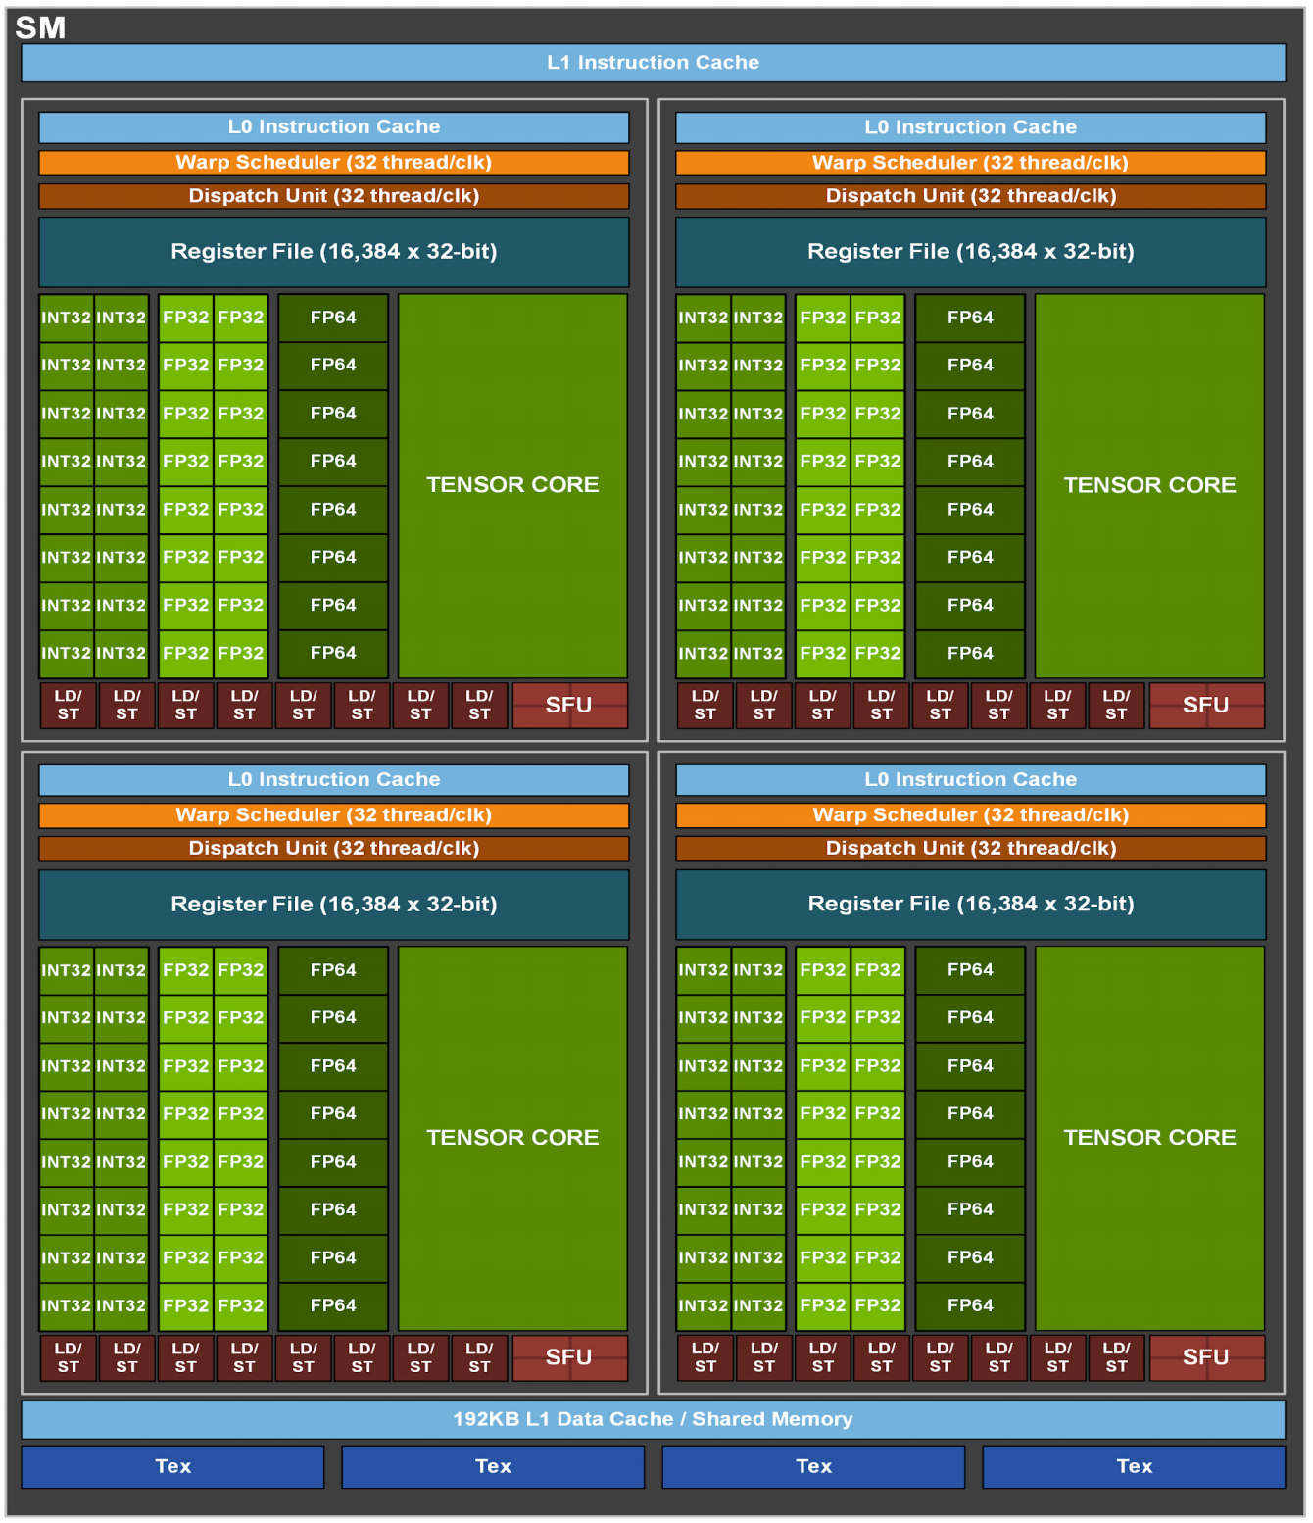
Streaming multiprocessor (SM)
SM contains four processing blocks that share an L1 cache for data caching.
Each processing block has a Warp scheduler
16 INT32 CUDA cores
16 FP32 CUDA cores
8 FP64 CUDA cores
8 Load/Store cores
Tensor core for matrix multiplication
16K 32-bit register file.
The maximum number of thread blocks per SM is 32.

Slide 8
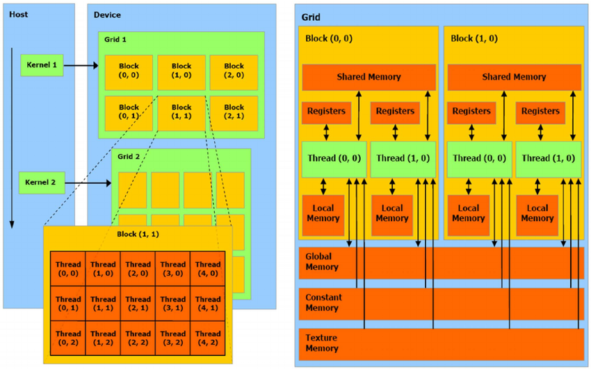
How to program a GPU
Single-Instruction-Multiple-Threads (SIMT).
SIMT allows GPUs to execute the same instruction across multiple threads
Perspective is a thread
Threads grouped into blocks
Blocks grouped into grids
Threads within block can access shared memory and synchronize
GPUs are designed to maximize throughput.
Transferring data from the CPU to the GPU can be a bottleneck

Slide 9
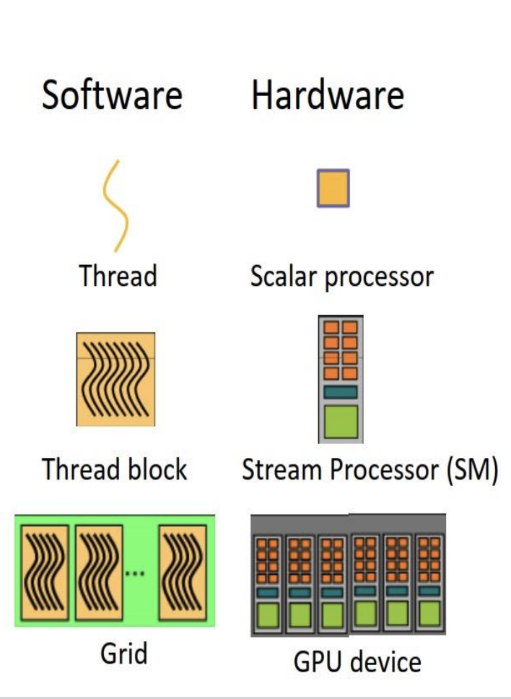
Mapping Software to Hardware
Thread: Smallest unit of execution, executes a kernel function.
Scalar Processor (core): Executes one thread. Multiple cores live inside an SM.
Thread Block: Group of threads executed on a single SM. Threads in a block can share memory and synchronize.
SM (Streaming Multiprocessor): Executes thread blocks. Contains cores, Tensor Cores, registers, shared memory, etc.
Grid: Collection of thread blocks. Can span across multiple SMs.
GPU Device: The full hardware accelerator; includes many SMs and memory hierarchies (L2 cache, global memory, etc.).

Slide 10
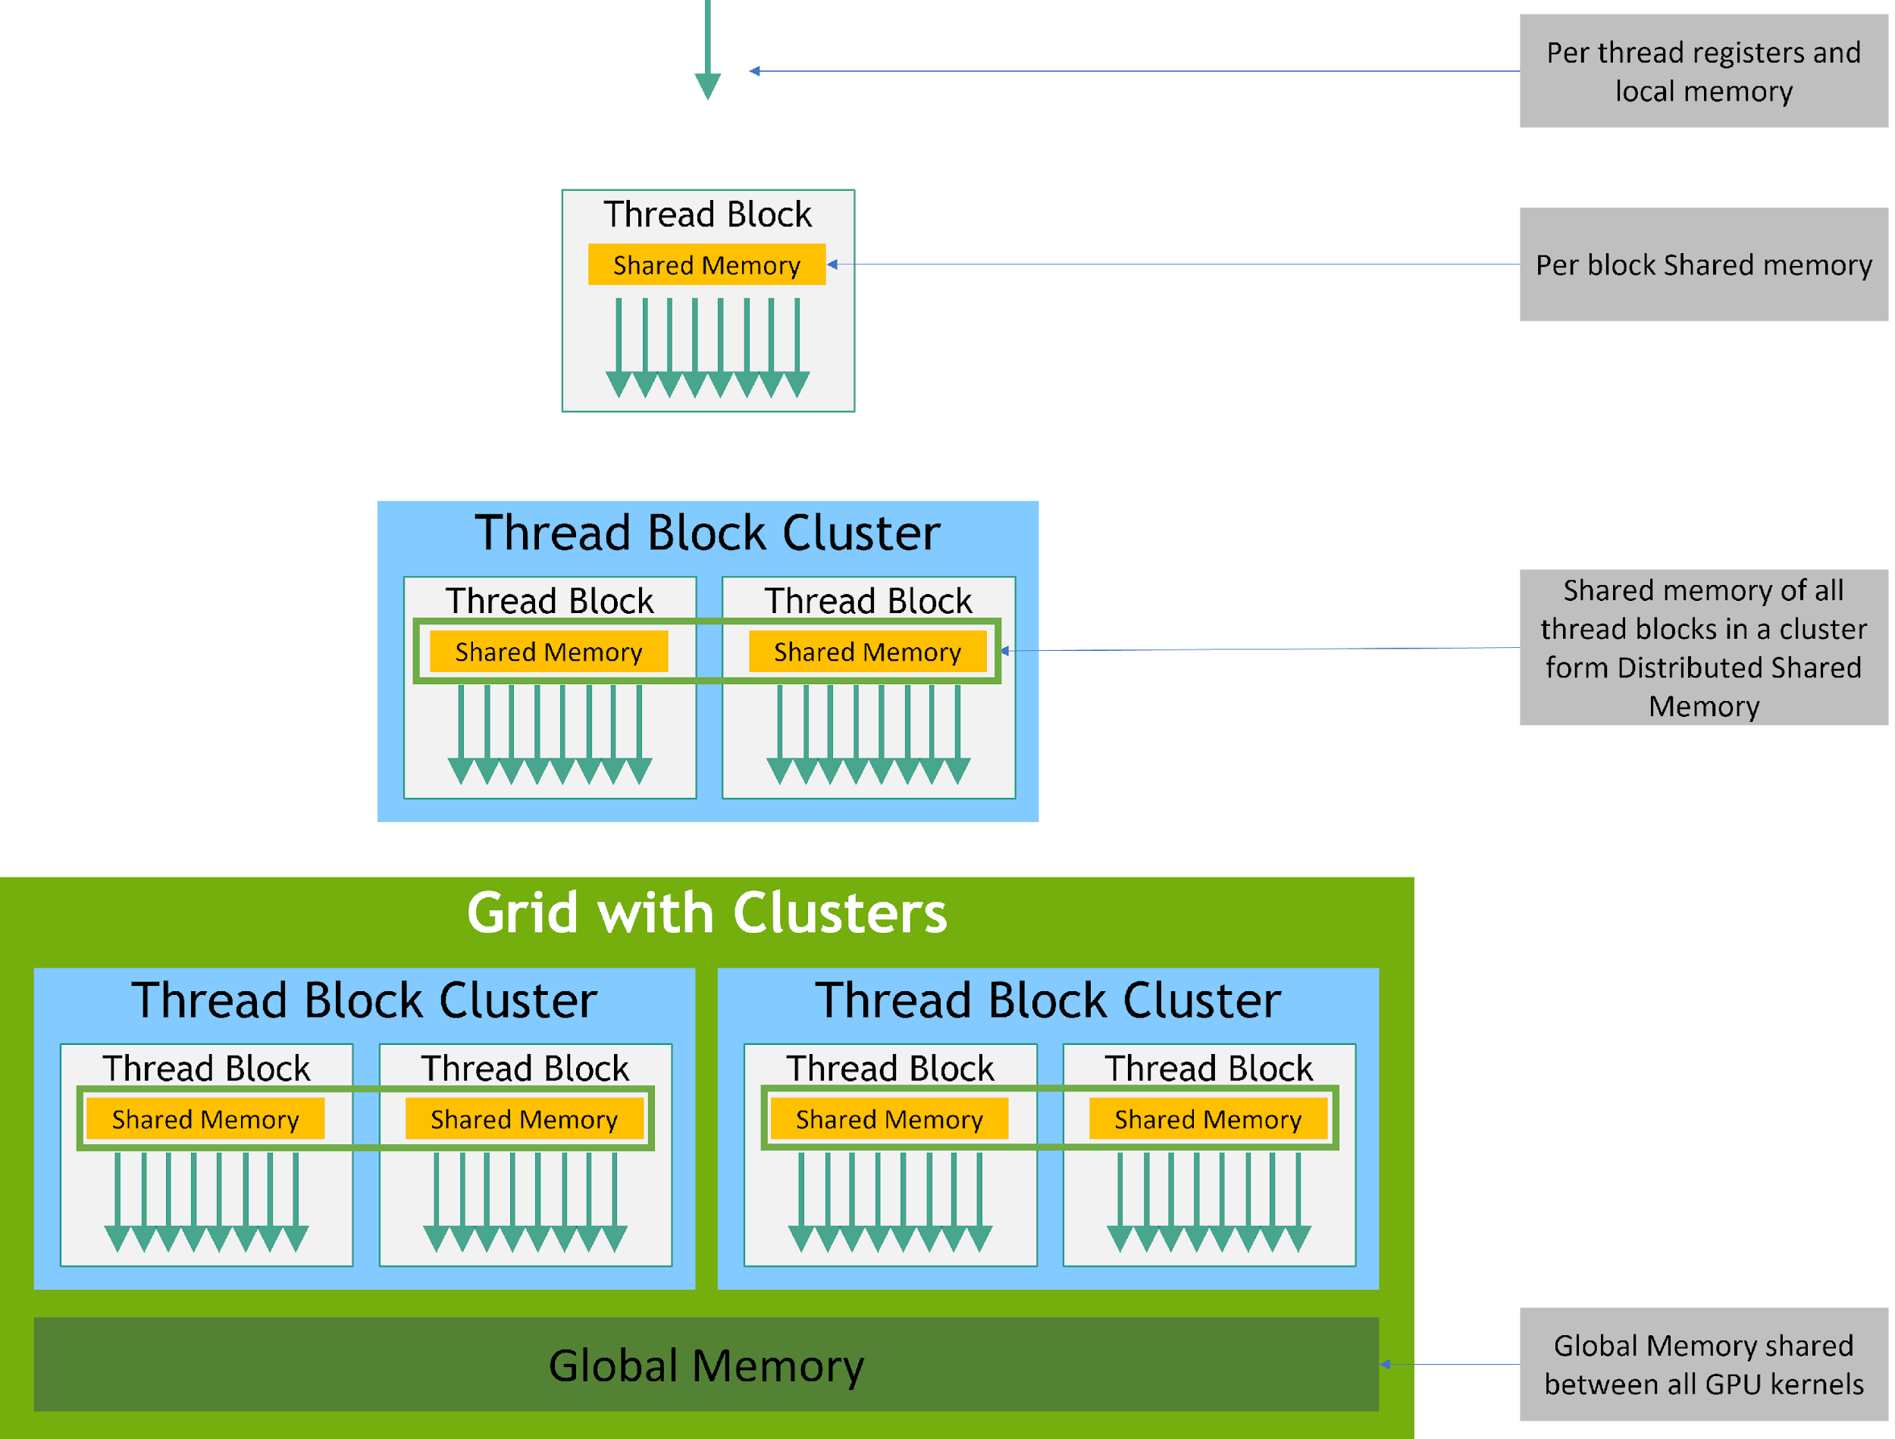
Memory Hierarchy
Each thread has private local memory.
Each thread block has shared memory visible to all threads of the block and with the same lifetime as the block.
Thread blocks in a thread block cluster can perform read, write, and atomics operations on each other’s shared memory.
All threads have access to the same global memory.

Slide 11
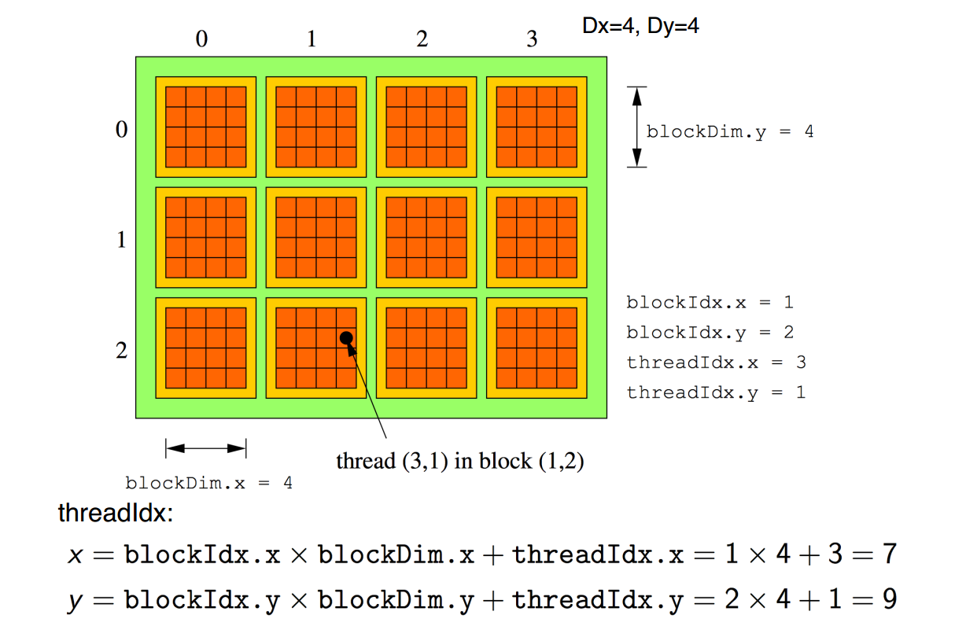
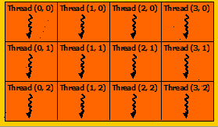
SIMT Programming model
Grid
x
Block
y
Global thread ID: the position of the thread within block (threadIdx) , the position of the block within the grid (blockIdx), and block dimension (blockDim)

Slide 12
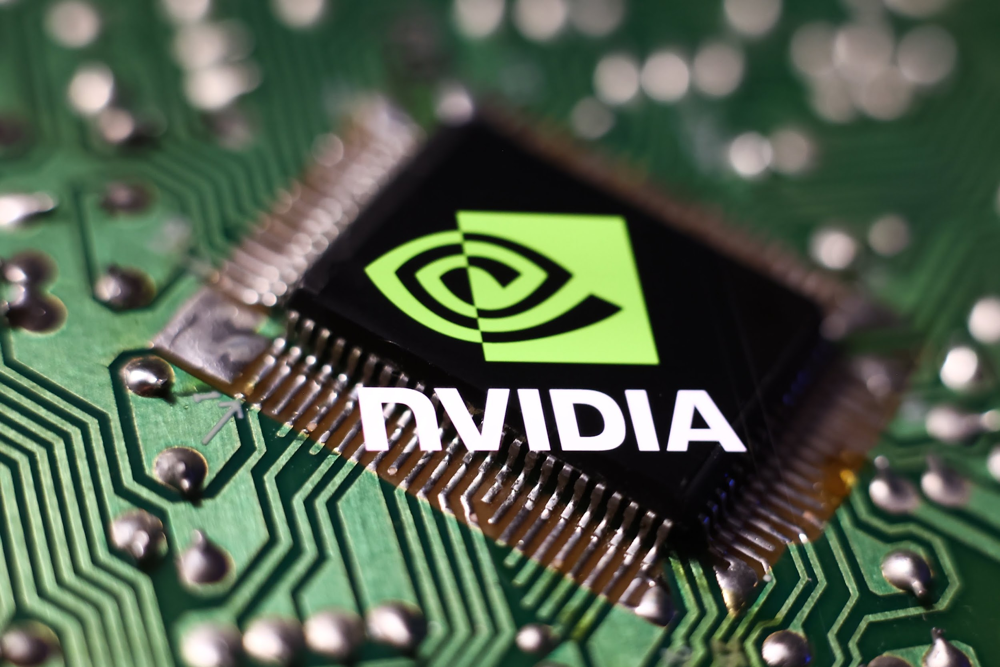
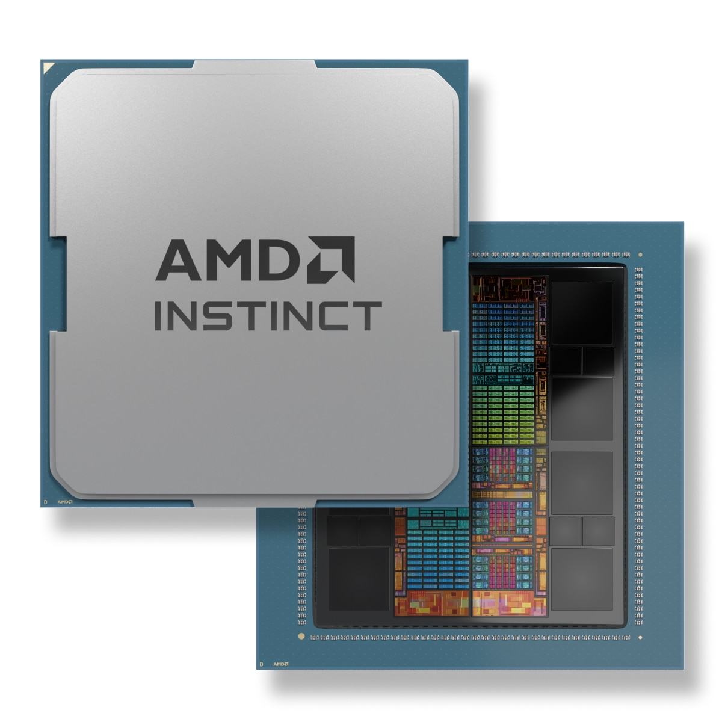
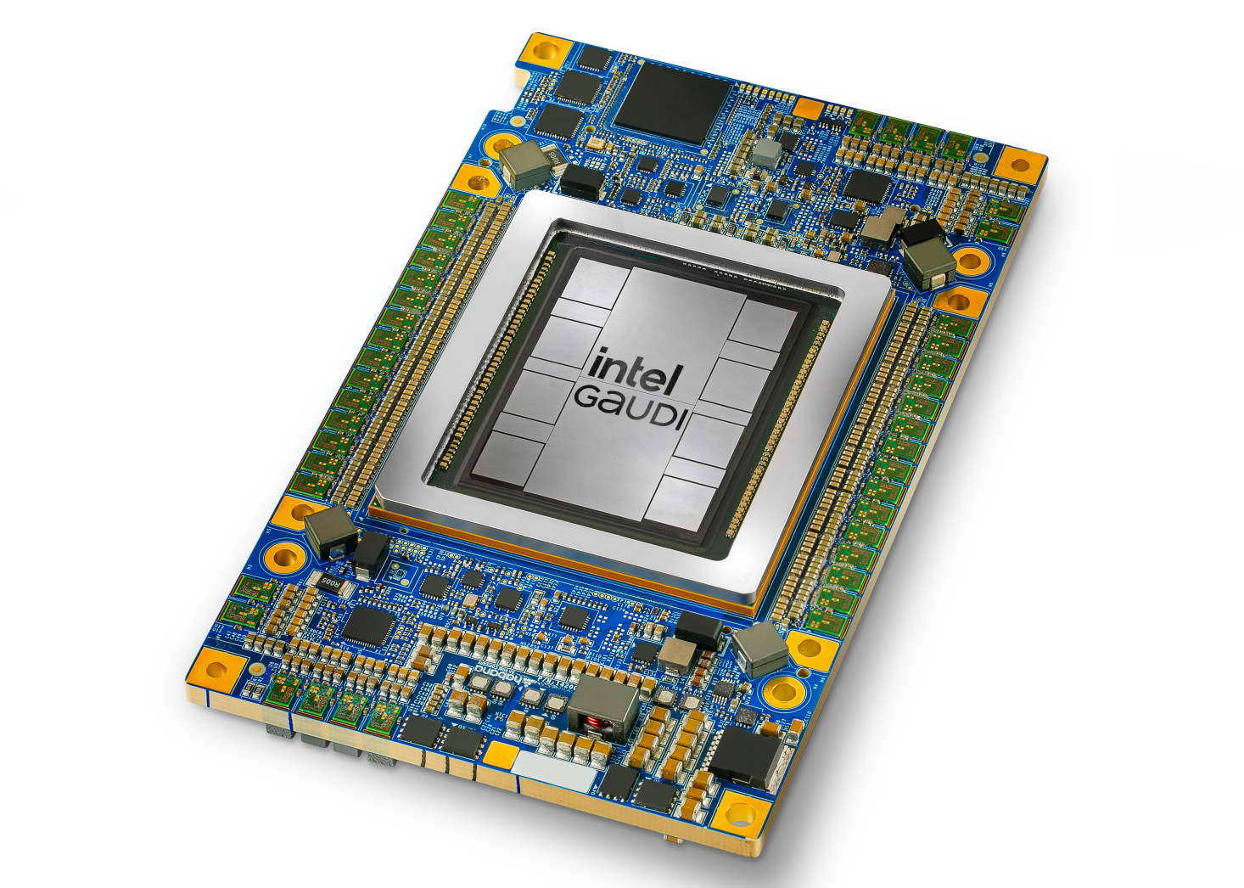

Existing GPUs and their Software
Hardware | NVIDIA | AMD | Intel | Apple
Software | CUDA | ROCm | OneAPI | Metal

Slide 13
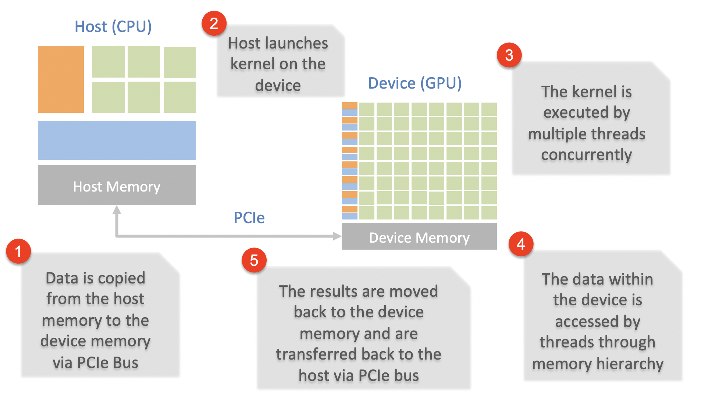
Typical Execution Dataflow

Slide 14
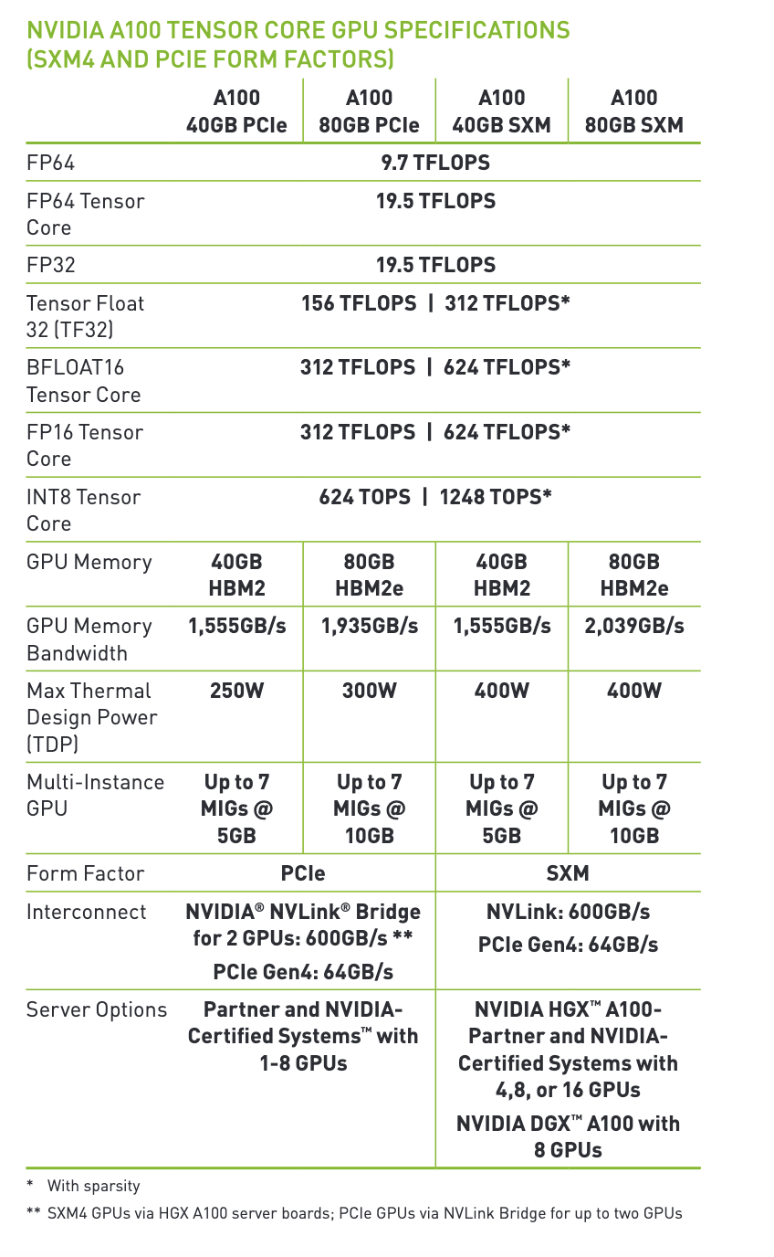
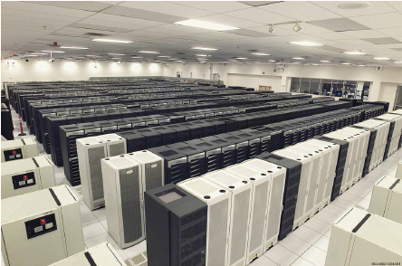
NVIDIA Ampere A100
An NVIDIA A100 GPU
It has 40 MB L2 cache, which helps reduce latency
It supports up to 80 GB of HBM2 memory with a maximum memory bandwidth of 2039 GB/s , essential for handling large data and reducing data transfer.
It contains in total 6912 FP32/INT32 CUDA cores and 3456 FP64 CUDA cores
NVIDIA H100: offers up to 30 TFLOPs of FP64 performance, which is over 3x the FP64 performance of the A100
GB200 Grace Blackwell Superchip: Provides 90 TFLOPS of FP64 performance
ASCI White supercomputer
Lawrence Livermore National Laboratory
Top #1 in 2007, 7.9 TFLOPS

Slide 15

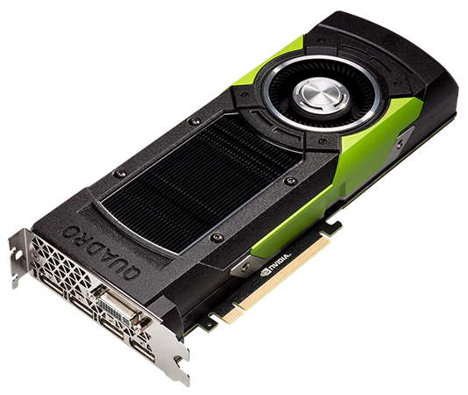
NVIDIA CUDA: CUDA.jl
AMD ROCm: AMDGPU.jl
Intel oneAPI: oneAPI.jl
Performance portability layer: KernelAbstractions.jl
Notes:
Several back-ends with similar structure: API package, kernel package, array package.
oneAPI has them all merged into a single package.
Focus on CUDA stack: most mature.

Slide 16



Installation
pkg> add CUDA
julia> using CUDA
julia> CUDA.version()
Downloading artifact: CUDA10.2
Downloading artifact: CUDNN+CUDA10.2
Downloading artifact: CUTENSOR+CUDA10.2
v"10.2.89"
julia> CUDA.functional()
true
Automatic installation of CUDA
  lazily, on first use
  unless the environment contains JULIA_CUDA_USE_BINARYBUILDER=false
No need for Requires.jl
Container-friendly
Notes:
Trivial installation, nowadays. Only requires NVIDIA driver.

Slide 17
Array programming
julia> CuArray{Float32,2}(undef, 2, 2)
2×2 CuArray{Float32,2}:
0.0 0.0
0.0 0.0
julia> similar(a)
1×3 CuArray{Int64,2}:
0 0 0
julia> a = CuArray([1 2 3])
1×3 CuArray{Int64,2}:
1 2 3
julia> b = Array(a)
1×3 Array{Int64,2}:
1 2 3
Goal: API compatibility with Base.Array
Notes:
Start your GPU application with: the CuArray type

Slide 18
Array programming
julia> CUDA.ones(2)
2-element CuArray{Float32,1}:
1.0
1.0
julia> CUDA.zeros(Float32, 2)
2-element CuArray{Float32,1}:
0.0
0.0
julia> CUDA.fill(42, (3,4))
3×4 CuArray{Int64,2}:
42 42 42 42
42 42 42 42
42 42 42 42
julia> rand(2, 2)
2×2 CuArray{Float32,2}:
0.73055 0.843176
0.939997 0.61159
Goal: API compatibility with Base.Array
Notes:
Convenience constructors

Slide 19
Array programming
julia> a = CuArray{Float32}(undef, (2,2));
CURAND
julia> rand!(a)
2×2 CuArray{Float32,2}:
0.73055 0.843176
0.939997 0.61159
CUBLAS
julia> a * a
2×2 CuArray{Float32,2}:
1.32629 1.13166
1.26161 1.16663
CUSOLVER
julia> LinearAlgebra.qr!(a)
CuQR{Float32,CuArray{Float32,2}}
with factors Q and R:
Float32[-0.613648 -0.78958; -0.78958 0.613648]
Float32[-1.1905 -1.00031; 0.0 -0.290454]
CUFFT
julia> CUFFT.plan_fft(a) * a
2-element CuArray{Complex{Float32},1}:
-1.99196+0.0im 0.589576+0.0im
-2.38968+0.0im -0.969958+0.0im
CUDNN
julia> softmax(real(ans))
2×2 CuArray{Float32,2}:
0.15712 0.32963
0.84288 0.67037
CUSPARSE
julia> sparse(a)
2×2 CuSparseMatrixCSR{Float32,Int32}
with 4 stored entries:
[1, 1] = -1.1905
[2, 1] = 0.489313
[1, 2] = -1.00031
[2, 2] = -0.290454
Notes:
When possible, we reuse NVIDIA’s libraries for performance.

Slide 20
Array programming
julia> a = CuArray([1 2 3])
julia> b = CuArray([4 5 6])
julia> map(a) do x
x + 1
end
1×3 CuArray{Int64,2}:
2 3 4
julia> a .+ 2b
1×3 CuArray{Int64,2}:
9 12 15
julia> reduce(+, a)
6
julia> accumulate(+, b; dims=2)
1×3 CuArray{Int64,2}:
4 9 15
julia> findfirst(isequal(2), a)
CartesianIndex(1, 2)
Powerful array language: obviates need for custom kernels
makes it possible to write generic code
Notes:
Real power comes from higher-order array expressions

Slide 21
Vector Addition Example
CPU code
GPU (CUDA) kernel
vector_size = 1024
a = rand(1:4, vector_size)
b = rand(1:4, vector_size)
c = zeros(Int, vector_size)
function vadd(c, a, b)
Thread.@threads for i in 1:vector_size
c[i] = a[i] + b[i]
end
return
end
da = CuArray(a)
db = CuArray(b)
dc = CUDA.zeros(Int, size(a))
function vadd(c, a, b)
i = threadIdx().x
c[i] = a[i] + b[i]
return
end
@cuda threads=length(a) vadd(dc, da, db)
Notice: only local index
Any Ideas what is the limitation here?

Slide 22
Enhanced GPU Vector Addition
threadIdx().x + (blockIdx().x - 1) * blockDim().x = 3 + (3-1) * 256 = 515
Gets the global index of the thread in a multidimensional grid
gridDim().x = 2048
threadIdx().x
threadIdx().x
threadIdx().x
threadIdx().x
…
1 | 2 | 3 | … | 256
1 | 2 | 3 | … | 256
1 | 2 | 3 | … | 256
1 | 2 | 3 | … | 256
blockIdx().x = 1
blockIdx().x = 2
blockIdx().x = 3
blockIdx().x = 2048
da = CuArray(a)
db = CuArray(b)
dc = CUDA.zeros(Int, size(a))
function vadd(c, a, b)
i = threadIdx().x + (blockIdx().x - 1) * blockDim().x
c[i] = a[i] + b[i]
return
end
@cuda threads=1024 blocks=cld(length(da),1024) vadd(dc, da, db)

Slide 23
Notebook:
https://github.com/Rabab53/mit-parallel-computing-course/blob/main/Introduction_to_julia_gpu/gpu_introduction.ipynb
Notes:
https://drive.google.com/file/d/1v8hCrhw5bow8VaPwvDCxGejAcTkopnkX/view?usp=sharing

